Slide 1
Chapter 5
Tree Searching Strategies

Slide 2
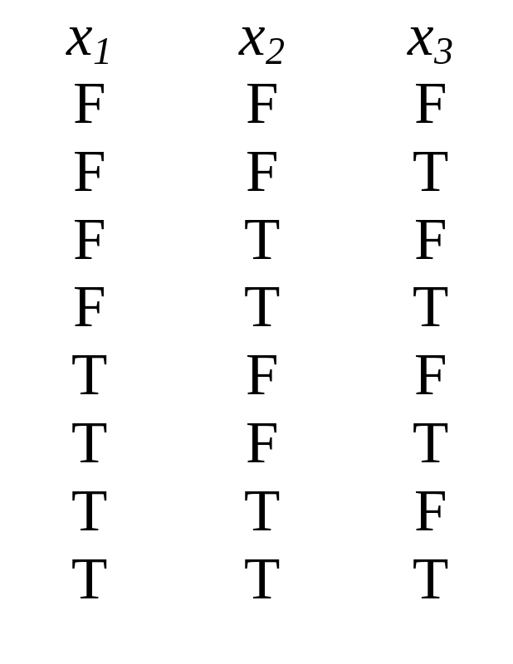
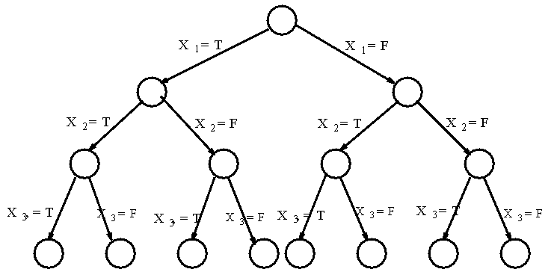
The Satisfiability Problem
Tree representation of 8 assignments.
If there are n variables x₁, x₂, …,x_{n}, then there are 2^{n} possible assignments.

Slide 3
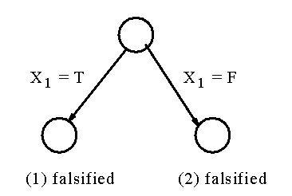
An instance:
  -x₁……..……(1)
  x₁…………..(2)
  x₂ v x₅….….(3)
  x₃…….…….(4)
  -x₂…….…….(5)
      A partial tree to determine the satisfiability problem.
We may not need to examine all possible assignments.

Slide 4
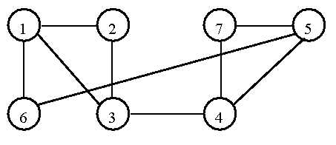
Hamiltonian Cycle Problem
A graph containing a Hamiltonian cycle.

Slide 5
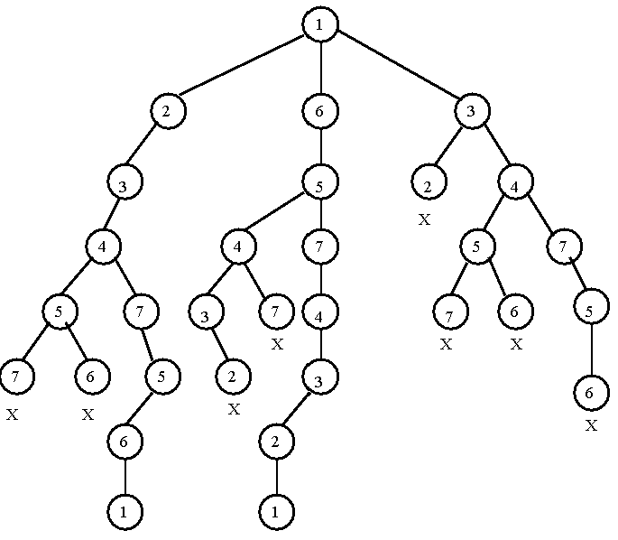
The tree representation of whether there exists a Hamiltonian cycle.

Slide 6
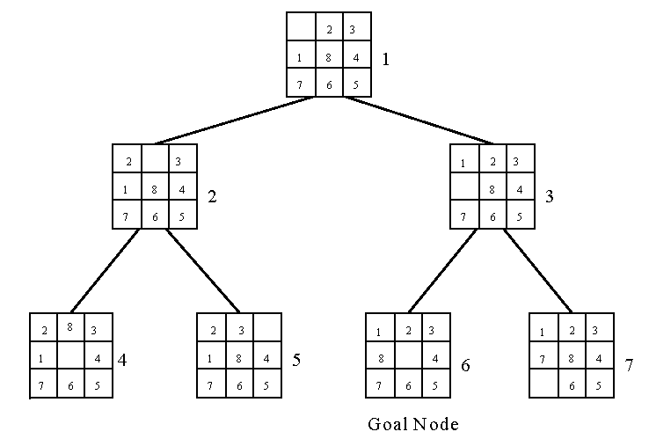
Breadth-First Search (BFS)
8-puzzle problem
The breadth-first search uses a queue to hold all expanded nodes.

Slide 7
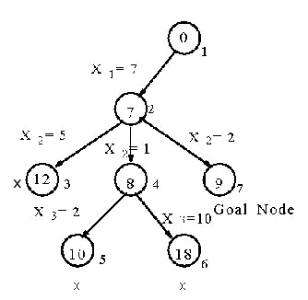
Depth-First Search (DFS)
e.g. sum of subset problem
S={7, 5, 1, 2, 10}
∃ S’ ⊆ S ∋ sum of S’ = 9?
A stack can be used to guide the depth-first search.
A sum of subset problem solved by depth-first search.

Slide 8
Hill Climbing
A variant of depth-first search
  The method selects the locally optimal node to expand.
e.g. 8-puzzle problem
evaluation function f(n) = d(n) + w(n),
where d(n) is the depth of node n
w(n) is # of misplaced tiles in node n.

Slide 9
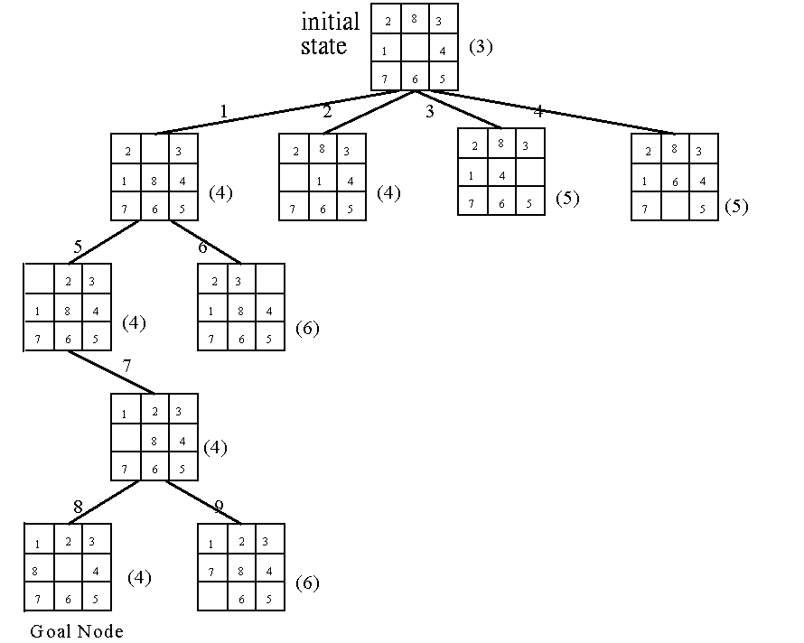
An 8-puzzle problem solved by a hill climbing method.

Slide 10
Best-First Search Strategy
Combine depth-first search and breadth-first search.
Select the node with the best estimated cost among all nodes.
This method has a global view.

Slide 11
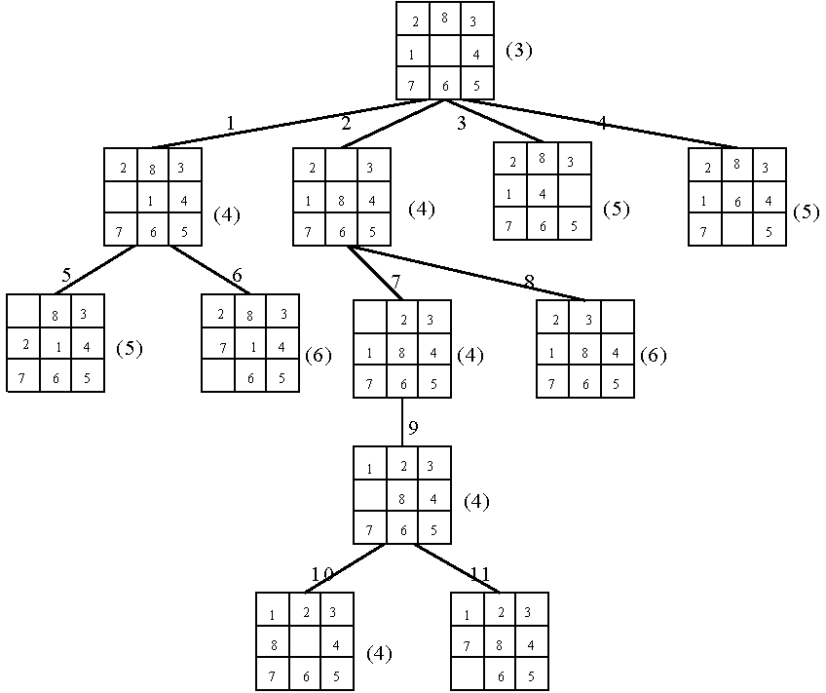
An 8-puzzle problem solved by a best-first search scheme.

Slide 12
Best-First Search Scheme
Step1: Form a one-element list consisting of the root node.
Step2: Remove the first element from the list. Expand the first element. If one of the descendants of the first element is a goal node, then stop; otherwise, add the descendants into the list.
Step3: Sort the entire list by the values of some estimation function.
Step4: If the list is empty, then failure. Otherwise, go to Step 2.

Slide 13
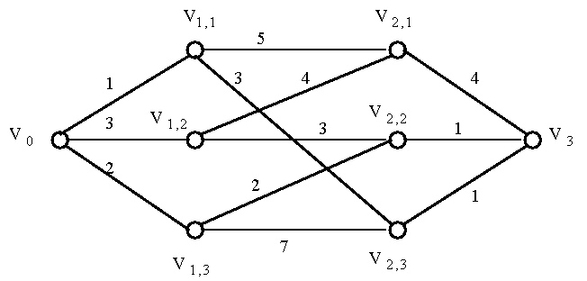
Branch-and-Bound Strategy
This strategy can be used to efficiently solve optimization problems.
e.g.
A multi-stage graph searching problem.

Slide 14
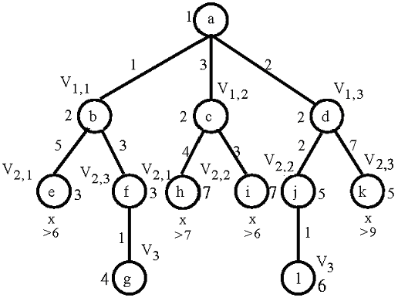
Solved by branch
-and-bound

Slide 15
Personnel Assignment Problem
A linearly ordered set of persons P={P₁, P₂, …, P_{n}} where P₁<P₂<…<P_{n}
A partially ordered set of jobs J={J₁, J₂, …, J_{n}}
Suppose that P_{i} and P_{j} are assigned to jobs f(P_{i}) and f(P_{j}) respectively. If f(P_{i}) ≤ f(P_{j}), then P_{i} ≤ P_{j}. Cost C_{ij} is the cost of assigning P_{i} to J_{j}. We want to find a feasible assignment with the minimum cost. i.e.
X_{ij} = 1 if P_{i} is assigned to J_{j}
X_{ij} = 0 otherwise.
Minimize ∑_{i,j} C_{ij}X_{ij}

Slide 16
e.g. A partial ordering of jobs
After topological sorting, one of the following topologically sorted sequences will be generated:
One of feasible assignments:
P₁→J₁, P₂→J₂, P₃→J₃, P₄→J₄
J₁
J₂
↓
↘
↓
J₃
J₄
J₁,
J₂,
J₃,
J₄
J₁,
J₂,
J₄,
J₃
J₁,
J₃,
J₂,
J₄
J₂,
J₁,
J₃,
J₄
J₂,
J₁,
J₄
J₃

Slide 17
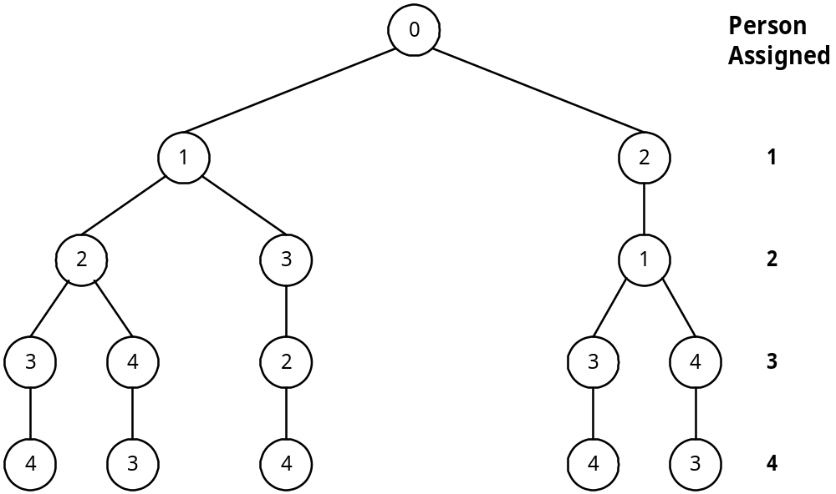
A Solution Tree
All possible solutions can be represented by a solution tree.
J₁
J₂
↓
↘
↓
J₃
J₄

Slide 18
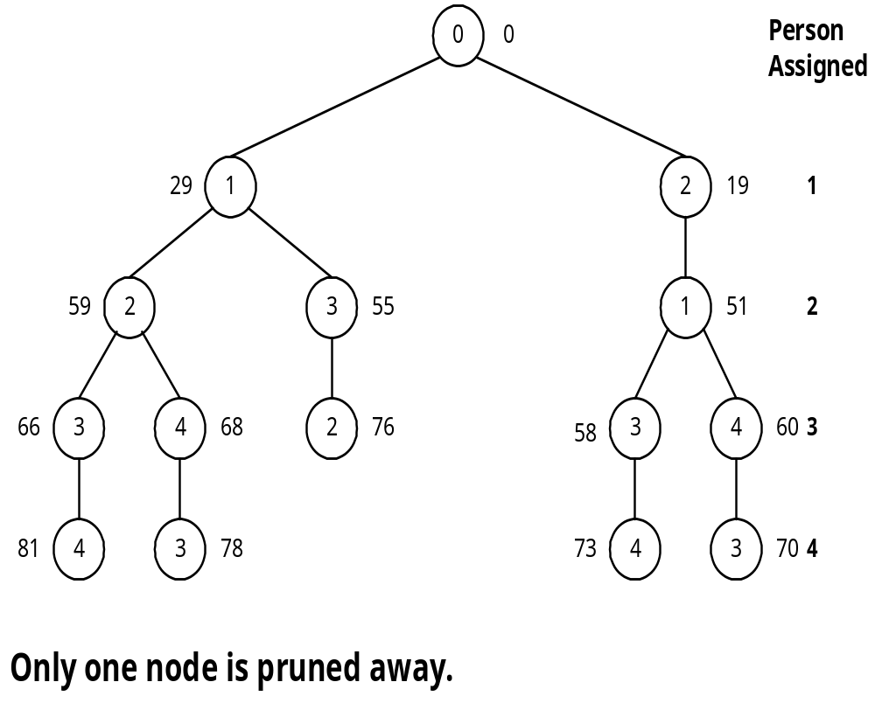
Cost Matrix
Apply the best-first search scheme:
Cost matrix
Jobs
Persons
1
2
3
4
1
29
19
17
12
2
32
30
26
28
3
3
21
7
9
4
18
13
10
15

Slide 19
Reduced Cost Matrix
Cost matrix
Reduced cost matrix
Jobs
Persons
1
2
3
4
Jobs
Persons
1
2
3
4
1
29
19
17
12
1
17
4
5
0
(-12)
2
6
1
0
2
(-26)
2
32
30
26
28
3
0
15
4
6
(-3)
3
3
21
7
9
4
8
0
0
5
(-10)
4
18
13
10
15
(-3)

Slide 20
A reduced cost matrix can be obtained:
subtract a constant from each row and each column respectively such that each row and each column contains at least one zero.
Total cost subtracted: 12+26+3+10+3 = 54
This is a lower bound of our solution.

Slide 21
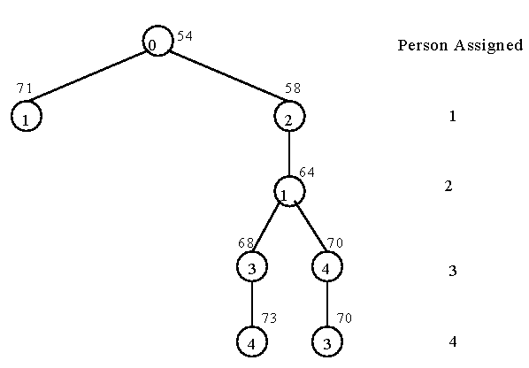
Branch-and-Bound for the Personnel Assignment Problem
Bounding of subsolutions:
Jobs
Persons
1
2
3
4
1
17
4
5
0
2
6
1
0
2
3
0
15
4
6
4
8
0
0
5

Slide 22
The Traveling Salesperson Optimization Problem
It is NP-complete.
A cost matrix
j
i
1
2
3
4
5
6
7
1
∞
3
93
13
33
9
57
2
4
∞
77
42
21
16
34
3
45
17
∞
36
16
28
25
4
39
90
80
∞
56
7
91
5
28
46
88
33
∞
25
57
6
3
88
18
46
92
∞
7
7
44
26
33
27
84
39
∞

Slide 23
A reduced cost matrix
j
i
1
2
3
4
5
6
7
1
∞
0
90
10
30
6
54
(-3)
2
0
∞
73
38
17
12
30
(-4)
3
29
1
∞
20
0
12
9
(-16)
4
32
83
73
∞
49
0
84
(-7)
5
3
21
63
8
∞
0
32
(-25)
6
0
85
15
43
89
∞
4
(-3)
7
18
0
7
1
58
13
∞
(-26)
Reduced: 84

Slide 24
Another reduced matrix
j
i
1
2
3
4
5
6
7
1
∞
0
83
9
30
6
50
2
0
∞
66
37
17
12
26
3
29
1
∞
19
0
12
5
4
32
83
66
∞
49
0
80
5
3
21
56
7
∞
0
28
6
0
85
8
42
89
∞
0
7
18
0
0
0
58
13
∞
(-7)
(-1)
(-4)
Total cost reduced: 84 + 7 + 1 + 4 = 96 (lower bound)

Slide 25
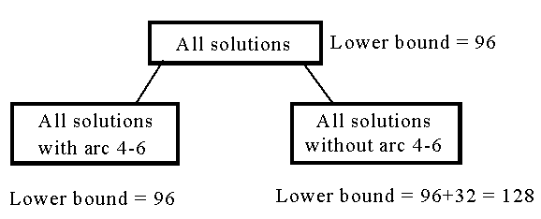
The highest level of a decision tree:
If we use arc 3-5 to split, the difference on the lower bounds is 17 + 1 = 18.

Slide 26
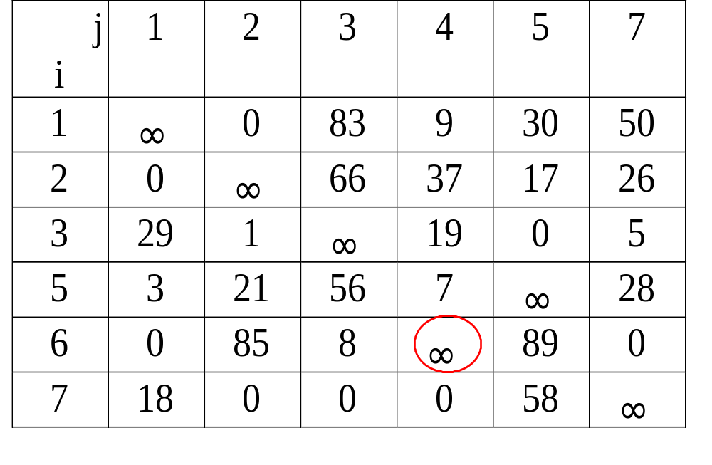
A reduced cost matrix if arc (4,6) is included in the solution.
Arc (6,4) is changed to be infinity since it cannot be included in the solution.

Slide 27
The reduced cost matrix for all solutions with arc 4-6.
Total cost reduced: 96 + 3 = 99 (new lower bound).
j
i
1
2
3
4
5
7
1
∞
0
83
9
30
50
2
0
∞
66
37
17
26
3
29
1
∞
19
0
5
5
0
18
53
4
∞
25
(-3)
6
0
85
8
∞
89
0
7
18
0
0
0
58
∞

Slide 28
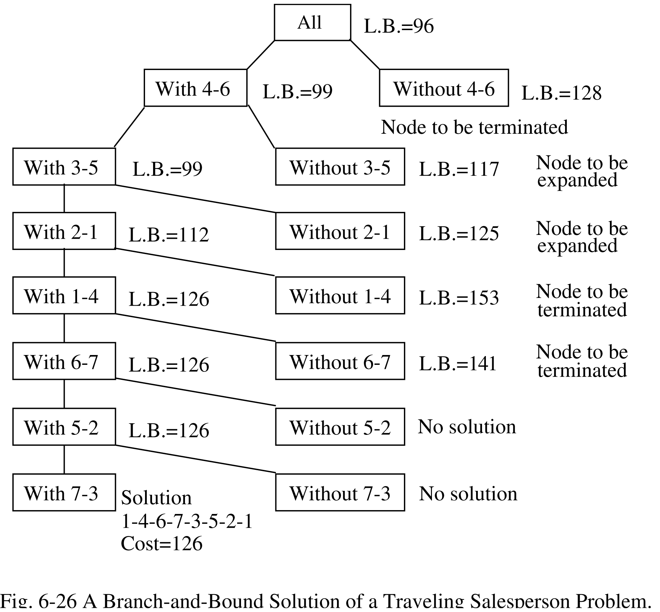
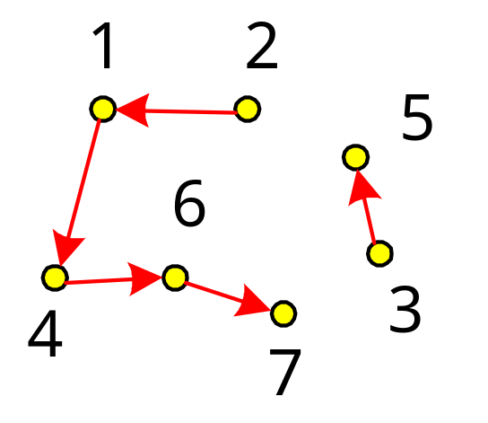
A branch-and-bound solution of a traveling salesperson problem.

Slide 29
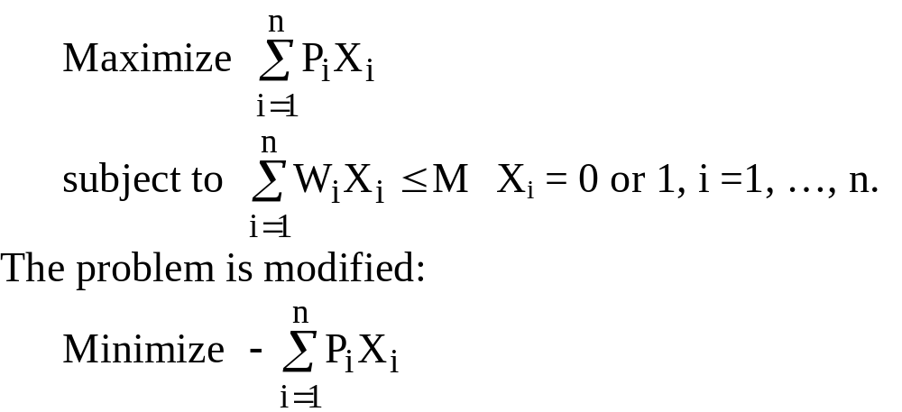
The 0/1 Knapsack Problem
Positive integers P₁, P₂, …, P_{n} (profit)
W₁, W₂, …, W_{n} (weight)
M (capacity)

Slide 30
e.g. n = 6, M = 34
A feasible solution: X₁ = 1, X₂ = 1, X₃ = 0, X₄ = 0, X₅ = 0, X₆ = 0
-(P₁+P₂) = -16 (upper bound)
Any solution higher than -16 cannot be an optimal solution.
i
1
2
3
4
5
6
P_{i}
6
10
4
5
6
4
W_{i}
10
19
8
10
12
8
(P_{i}/W_{i} ≥ P_{i+1}/W_{i+1})

Slide 31
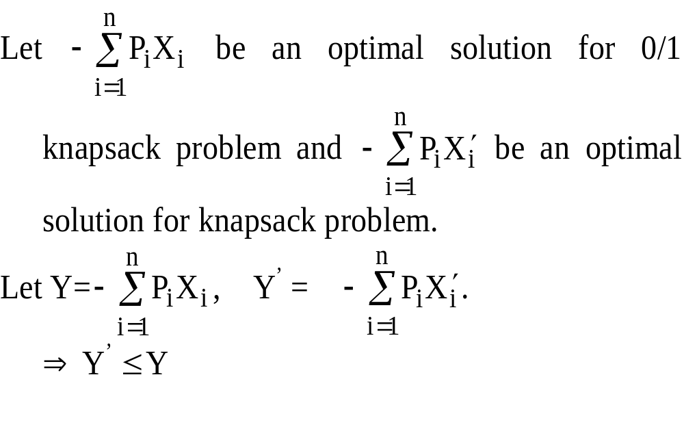
Relax the Restriction
Relax our restriction from X_{i} = 0 or 1 to 0 ≤ X_{i} ≤ 1 (knapsack problem)

Slide 32
Upper Bound and Lower Bound
We can use the greedy method to find an optimal solution for knapsack problem:
X₁ = 1, X₂ =1, X₃ = 5/8, X₄ = 0, X₅ = 0, X₆ =0
-(P₁+P₂+5/8P₃) = -18.5 (lower bound)
-18 is our lower bound (only consider integers)
⇒ -18 ≤ optimal solution ≤ -16
optimal solution: X₁ = 1, X₂ = 0, X₃ = 0, X₄ = 1, X₅ = 1, X₆ = 0
-(P₁+P₄+P₅) = -17

Slide 33
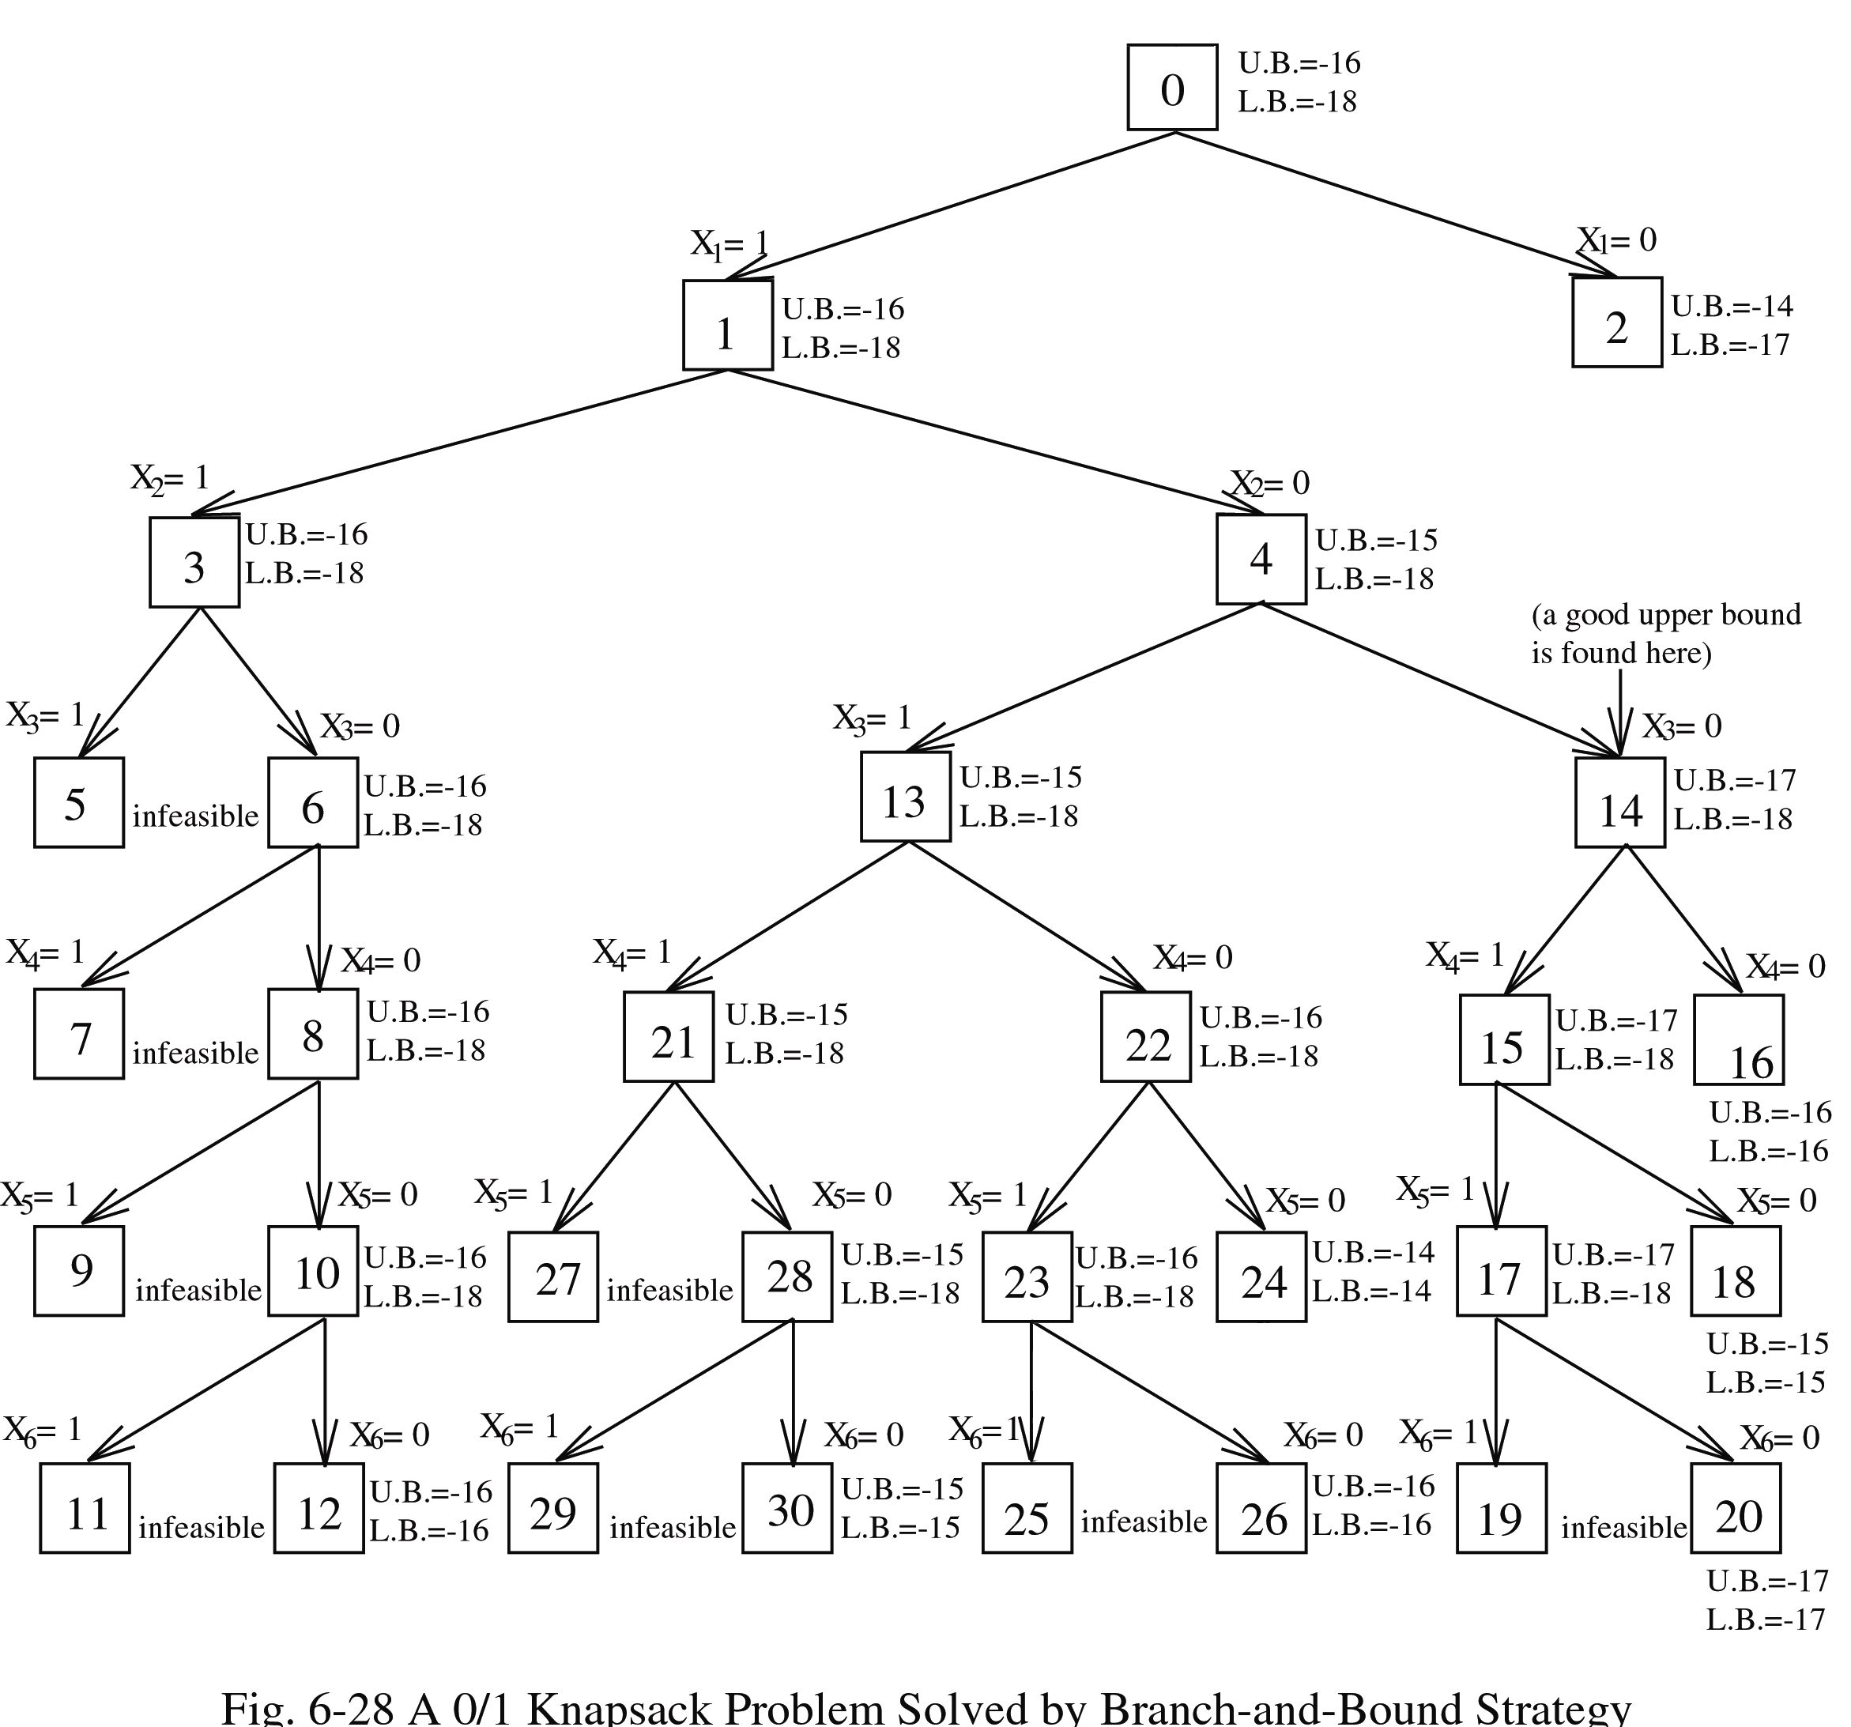
Expand the node with the best lower bound.
0/1 knapsack problem solved by branch-and-bound strategy.

Slide 34
The A* Algorithm
Used to solve optimization problems.
Using the best-first strategy.
If a feasible solution (goal node) is obtained, then it is optimal and we can stop.
Cost function of node n : f(n)
f(n) = g(n) + h(n)
g(n): cost from root to node n.
h(n): estimated cost from node n to a goal node.
h*(n): “real” cost from node n to a goal node.
If we guarantee h(n) ≤ h*(n), then
f(n) = g(n) + h(n) ≤ g(n)+h*(n) = f*(n)

Slide 35
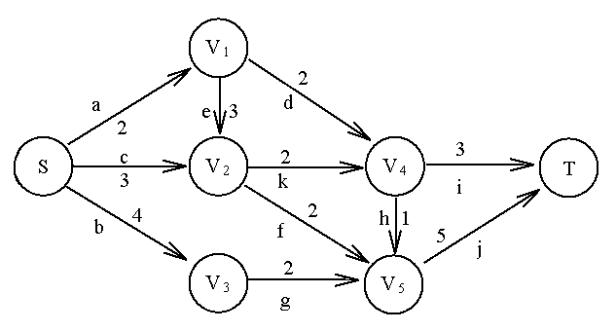
An Example for A* Algorithm
A graph to illustrate A* algorithm.
Stop if the selected node is also a goal node.

Slide 36
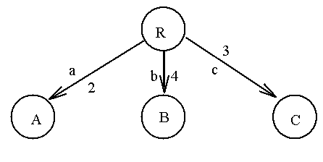
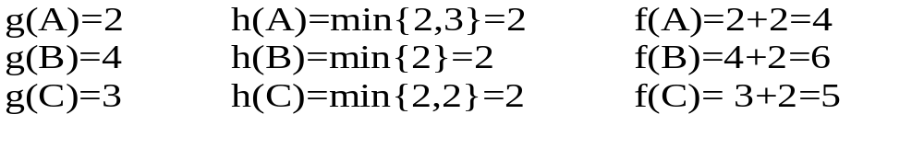
Step 1:

Slide 37
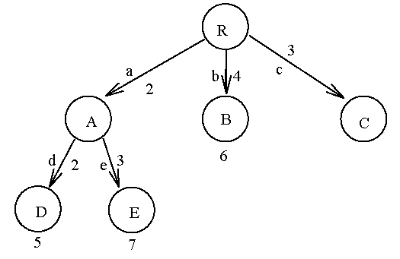
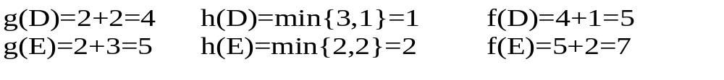
Step 2: Expand node A.

Slide 38
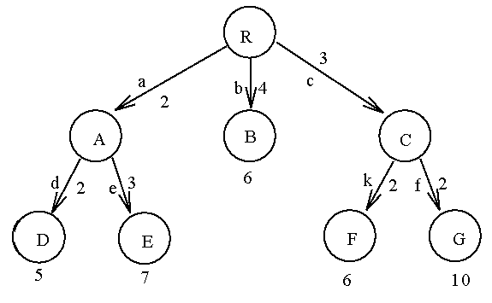
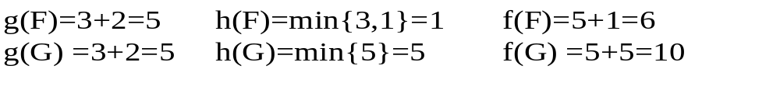
Step 3: Expand node C.

Slide 39
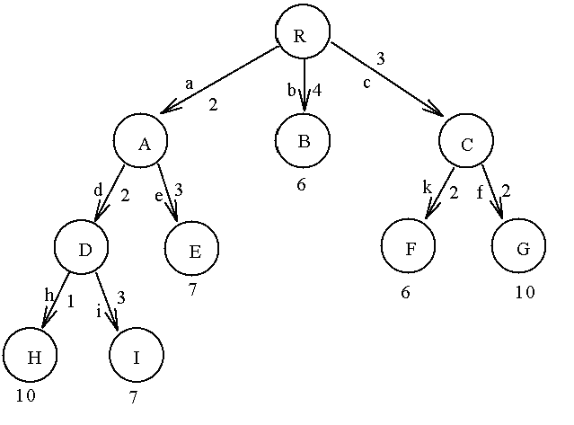
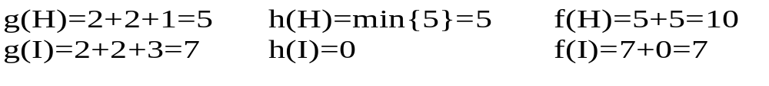
Step 4: Expand node D.

Slide 40
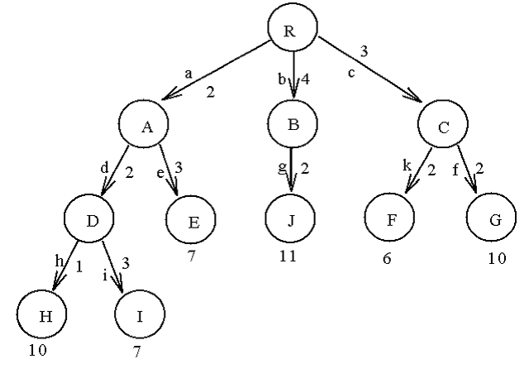
Step 5: Expand node B.

Slide 41
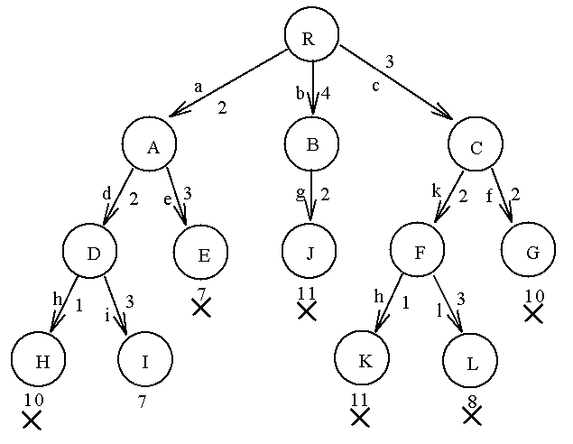
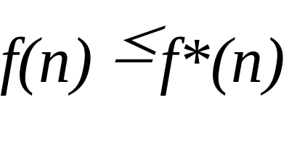
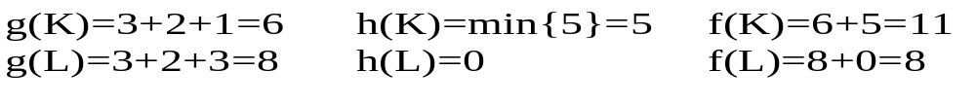
Step 6: Expand node F.
Node I is a goal node. Thus, the final solution is obtained.

Slide 42
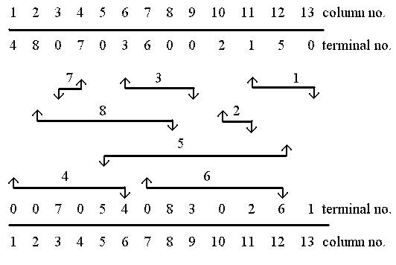
The Channel Routing Problem
A channel specification

Slide 43
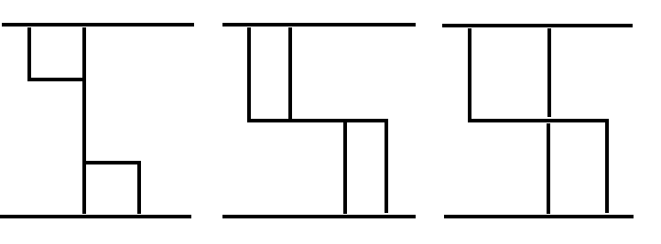
Illegal wirings:
We want to find a routing which minimizes the number of tracks.

Slide 44
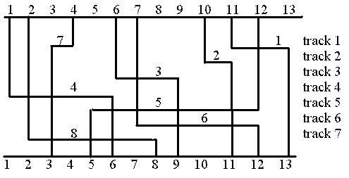
A Feasible Routing
7 tracks are needed.

Slide 45
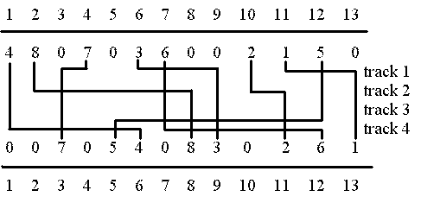
An Optimal Routing
4 tracks are needed.
This problem is NP-complete.

Slide 46
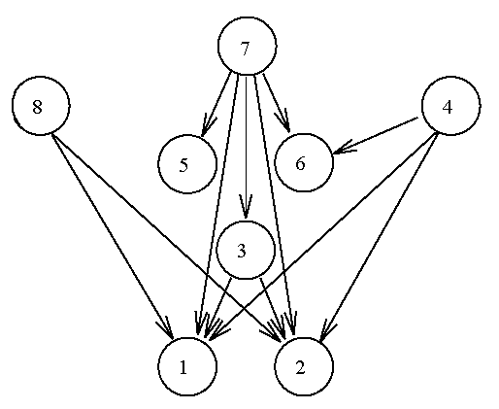
A* Algorithm for the Channel Routing Problem
Horizontal constraint graph (HCG).
e.g. net 8 must be to the left of net 1 and net 2 if
they are in the same track.

Slide 47
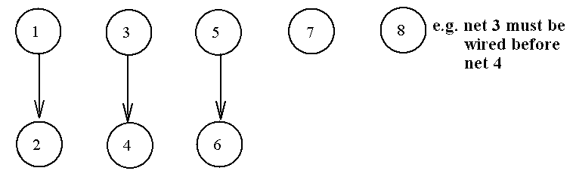
Vertical constraint graph:
Maximum cliques in HCG: {1,8}, {1,3,7}, {5,7}. Each maximum clique can be assigned to a track.

Slide 48
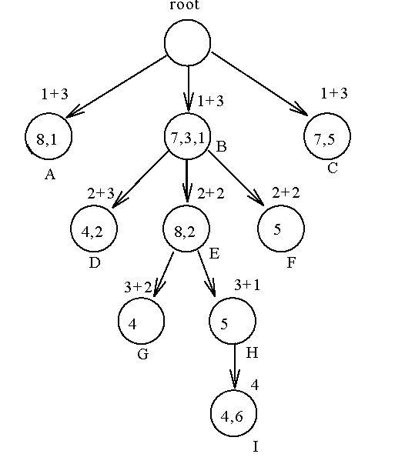
f(n) = g(n) + h(n),
  g(n): the level of the tree
  h(n): maximal local density
A partial solution tree for the channel routing problem by using A* algorithm.

